Slide 1



Women in the Civic Arena
Information Session

Slide 2
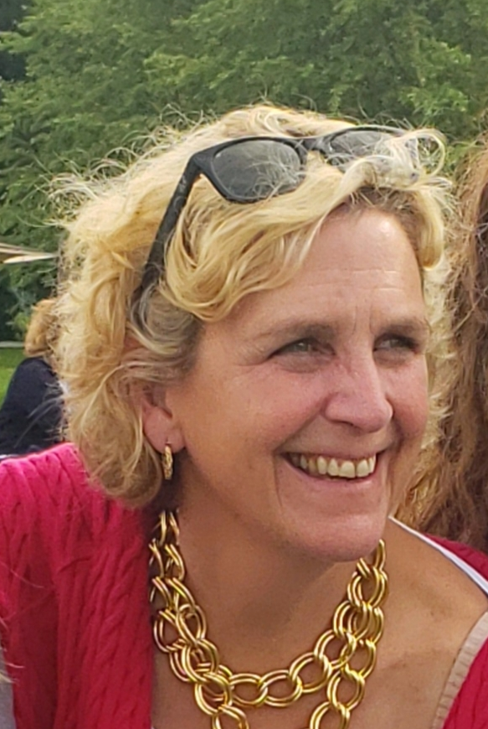
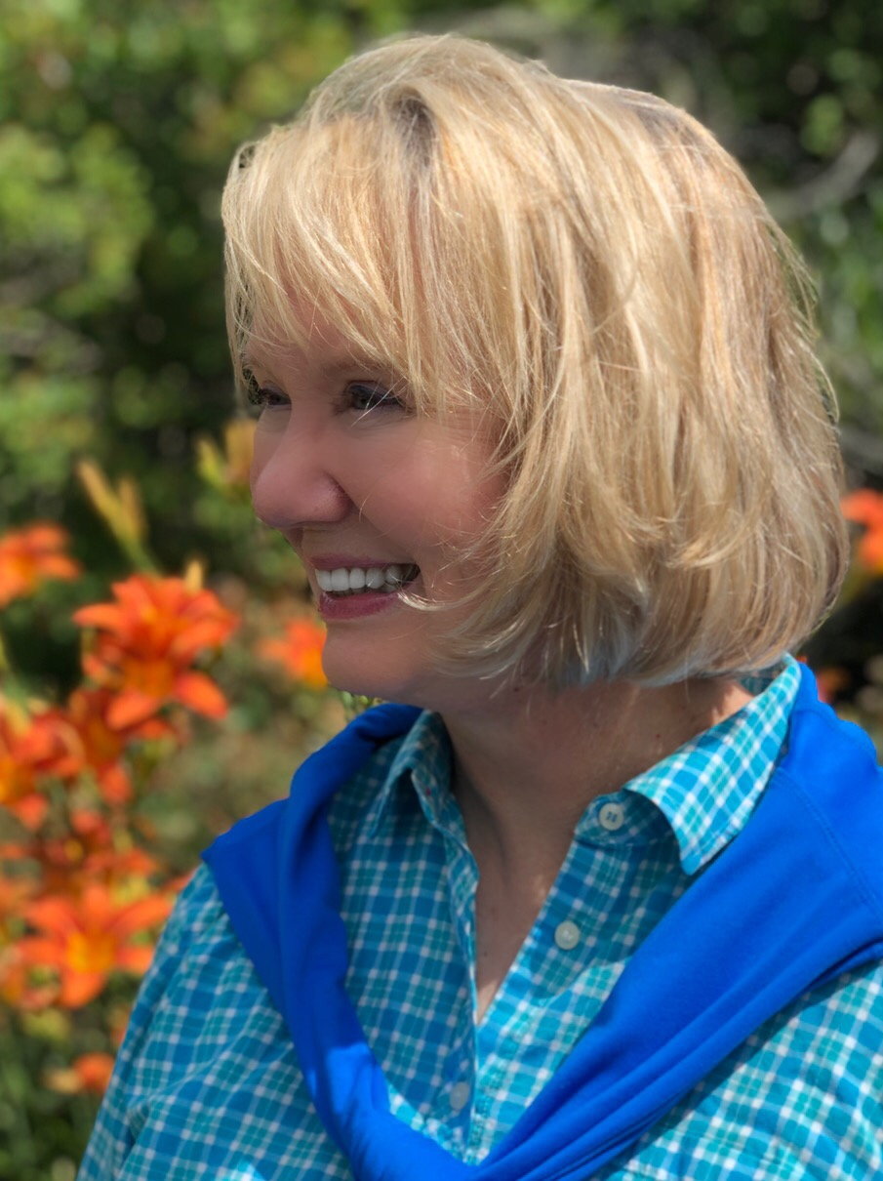
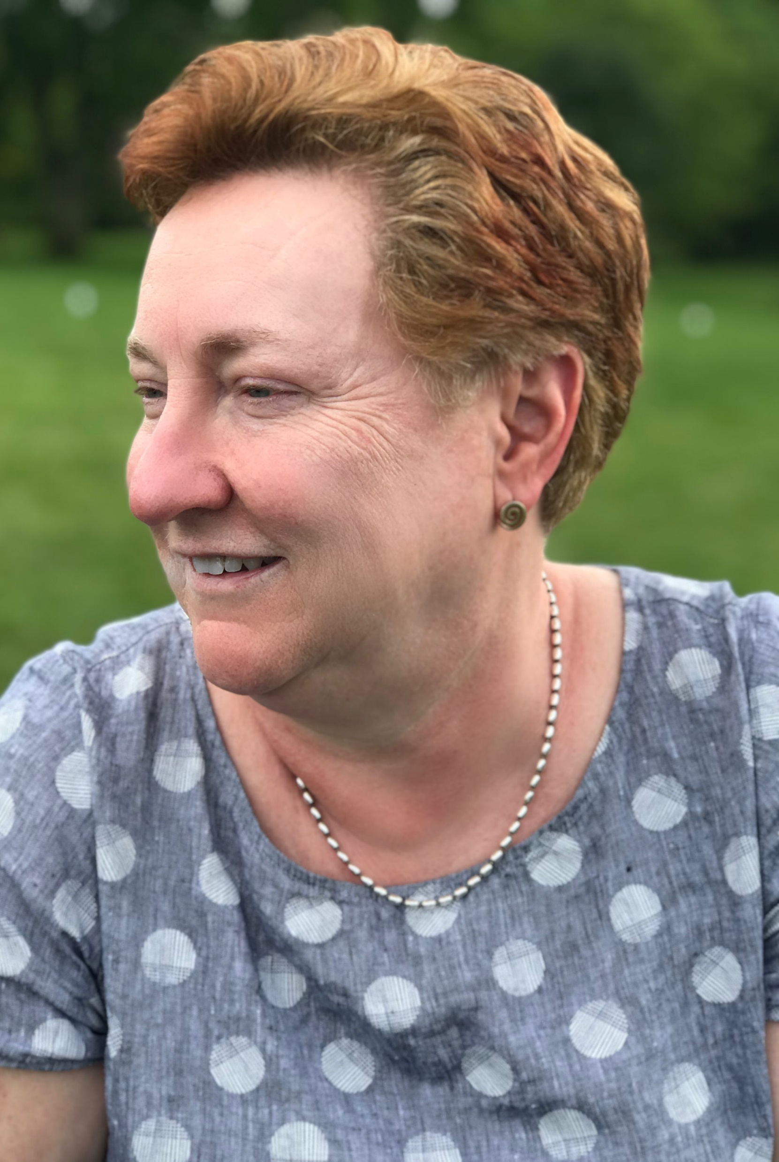
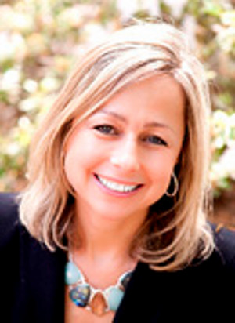
Faculty
Kate Fitzpatrick, ICMA Northeast Region Director
Felicia Logan, Executive Trainer and Facilitator
Peggy Merriss, Executive Director – Georgia City-County Management Association
Kendra Stewart, Director – The Riley Center for Livable Communities

Slide 3
Women in the Civic Arena
The program offers:
Information, research and lessons learned on overcoming challenges facing women in leadership in local government.
A safe space for discussion and problem solving.
Planning and accountability for living your whole, authentic life.
Camaraderie, joy, and fun.

Slide 4
Women in the Civic Arena
The program includes:
Discussing professional and personal challenges and goals
Understanding your approach to resilience
Learning from each other and guest speakers
Thinking and planning for how you want to live the rest of your life.

Slide 5
Agenda
 |  |  | Women in the Arena - Draft Overview Schedule
Thursday | January 15th | Friday | January 16th |  | Saturday | January 17th |  | Sunday | January 18th
Travel In |  | Breakfast on Your Own |  |  | Breakfast on Your Own |  |  | Breakfast on Your Own
 |  | Convene | 8:30am |  | Convene | 8:30am |  | Convene | 8:30am
 |  | Opening | 8:35am |  | Opening | 8:35am |  | Opening | 8:35am
 |  | Connnection | 8:45am |  | Connection | 8:45am |  | Connection | 8:45am
 |  | Break | 10:00am |  | Session #4 | 9:00am |  | Session #7 | 9:00am
 |  | Session #1 | 10:15am |  | Break | 10:00am |  | Break | 10:30am
 |  | Lunch | 11:45am |  | Session #5 | 10:30am |  | Closing | 10:45am
 |  | Session #2 | 1:00pm |  | Lunch | 11:45 am |  | Departure | 12:00pm
 |  | Break | 2:15pm |  | Session #6 | 1:00pm
 |  | Session #3 | 2:45pm |  | Wrap-up | 2:30pm
 |  | Wrap-up | 4:00pm
Meet in Hotel Lobby | 6:15pm | Meet in Hotel Lobby | 6:15pm |  | Meet at Restaurant | 6:15pm
Dinner | 6:30pm - 8:30pm | Dinner | 6:30pm - 8:30pm |  | Dinner | 6:30pm - 8:30pm

Slide 6
What’s Next…..
Applications are available at:
College of Charleston | Women in the Civic Arena
January 7th @12:00 PM EST Pre-session zoom meeting for participants, and pre-session work is sent to Participants
January 15 – 18, 2026 Program happens!

