Slide 1
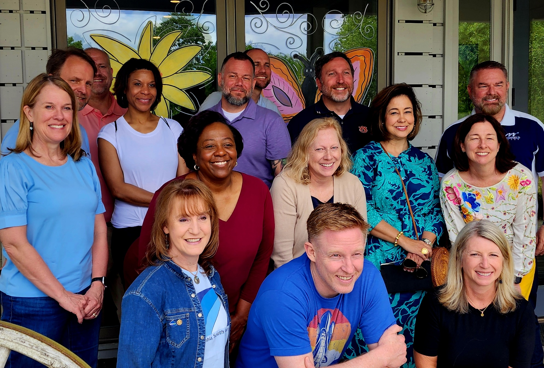
Athenian Program 25 Information Session

Slide 2
Athenian Program 25 Information Session
Who: Managers & Assistants with 10+ years of continuing service in local government
When: March 30 - April 4, 2025
Where: Inn at the Crossroads in Lake City, SC
Tuition: $5,750 includes lodging, all meals and materials (excludes travel)
College of Charleston | Athenian Program

Slide 3
The Athenian Program is grounded in the Athenian Oath.
A journey to transmit yourself, your community, and the profession greater and more beautiful than each was transmitted to you.
An opportunity for servant leaders to connect, ignite their passion, and define their legacy, understanding:
If not us, who will lead in these times?
If not now, when?

Slide 4
Sunday | Monday | Tuesday | Wednesday | Thursday | Friday
 | Breakfast | Breakfast | Breakfast | Breakfast | Breakfast
 | Connection B4 Content | Connection B4 Content | Connection B4 Content | Connection B4 Content | Connection B4 Content
 | Plenary-Socratic Challenges | Plenary-Community | Work with Subject Matter Expert | Plenary- The Profession | Review program
 | Identify Socratic Challenges, groups | Group meeting | Outdoor Exploration | Group work session | Next steps-on to 2025 conference
 | Lunch | Lunch | Lunch | Lunch
Arrive by 2pm | Plenary-personal challenges | Activity or Ted Talk and discussion | Subject Matter Expert Workshop I | Subject Matter Expert Workshop III
Connection B4 Content | Group selection for personal challenges | Group meeting | Small Group Meetings | Group meets
Break |  | Thinking time |  | Journaling/thinking time
Reception and Dinner | Reception and Dinner | Reception and Dinner | Picnic Dinner | Reception and Dinner
What Does the Week Look Like??????

Slide 5
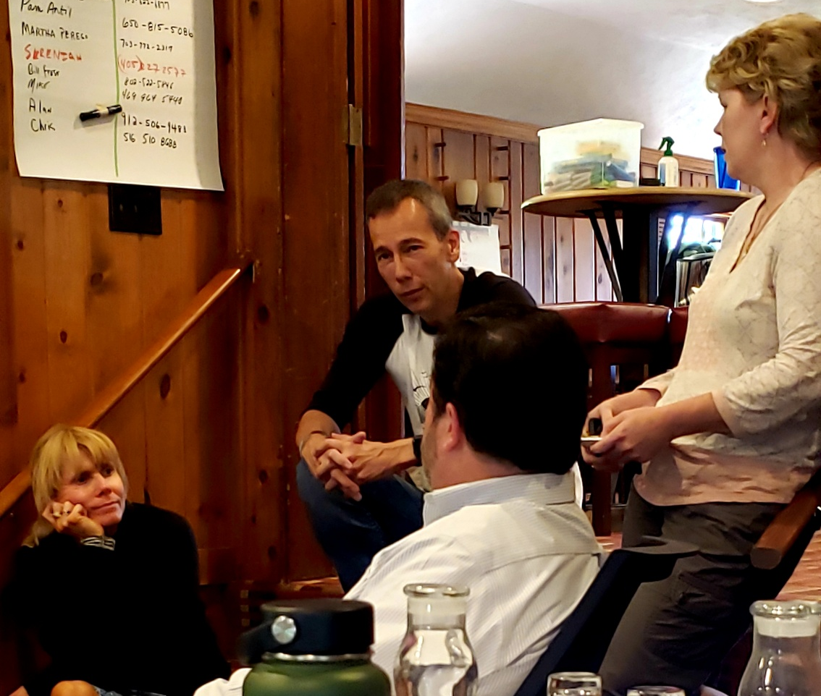
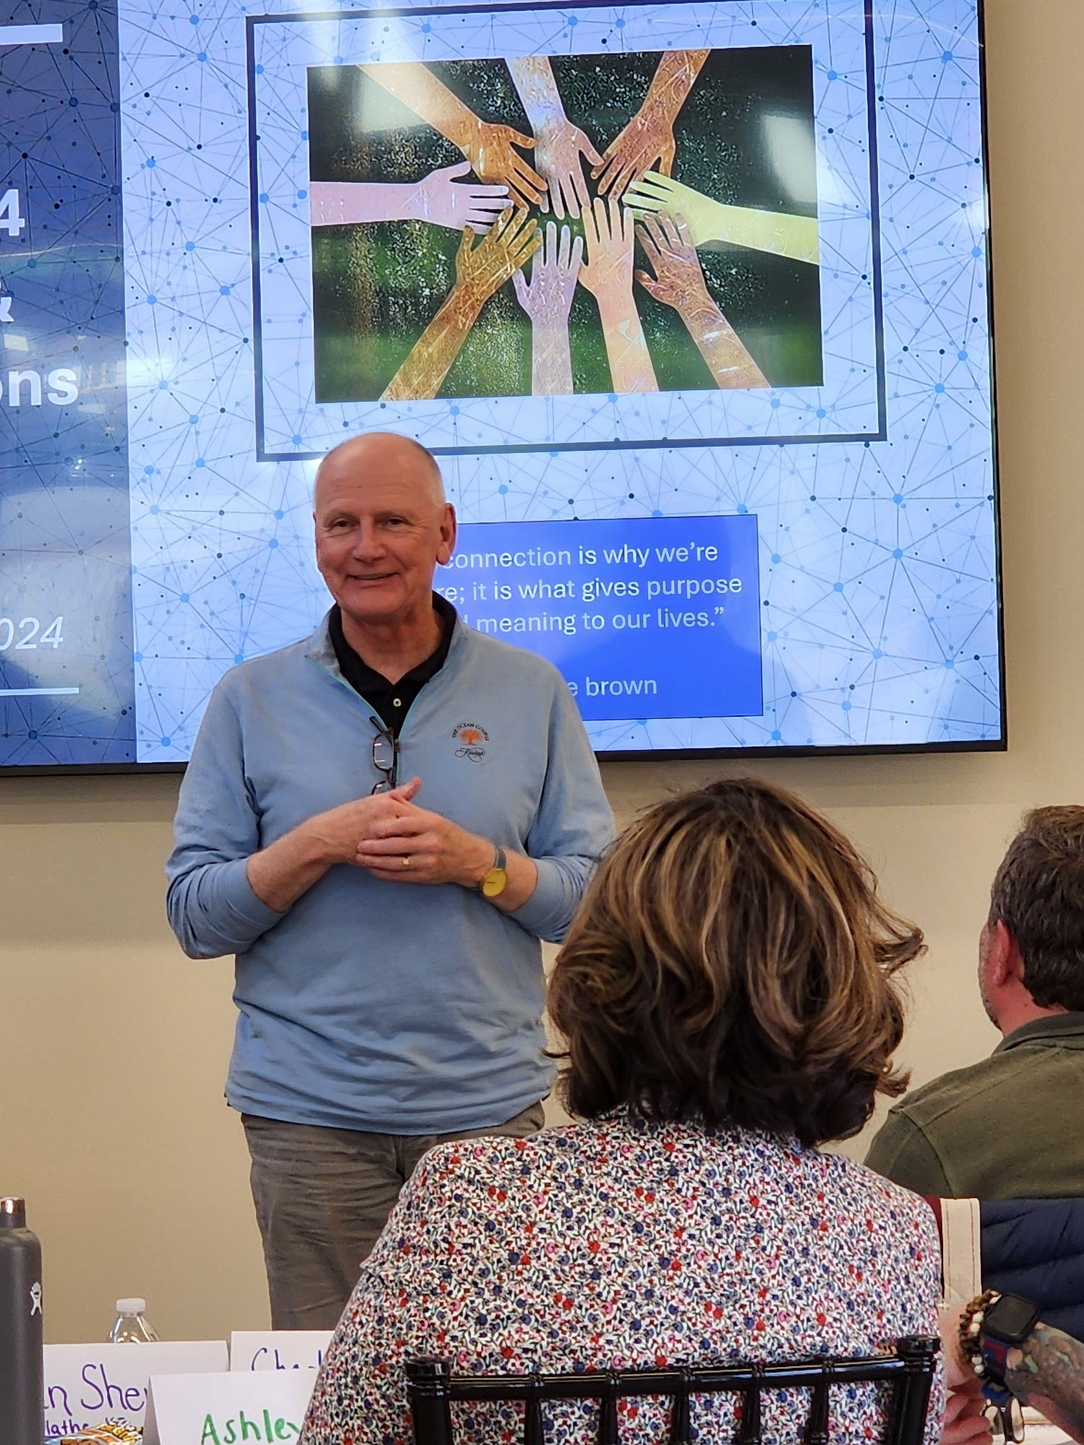

Slide 6
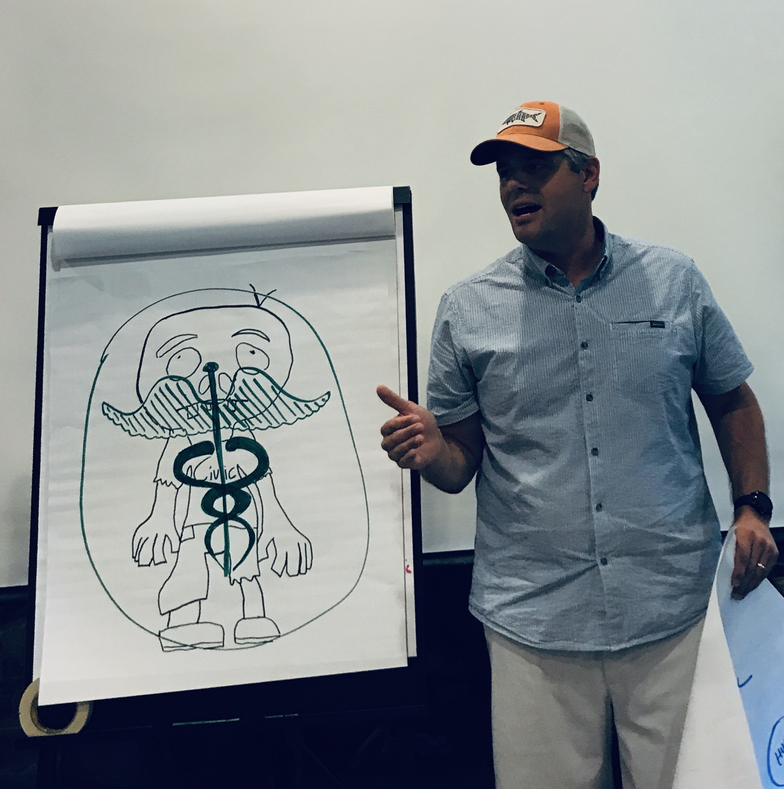
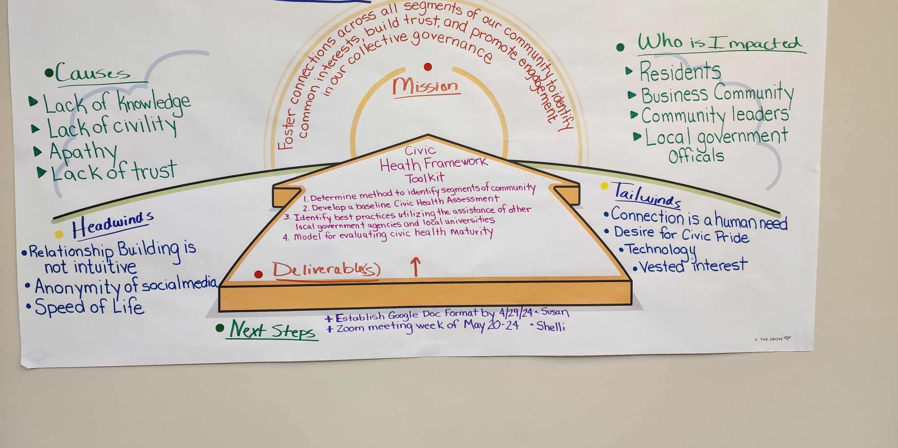
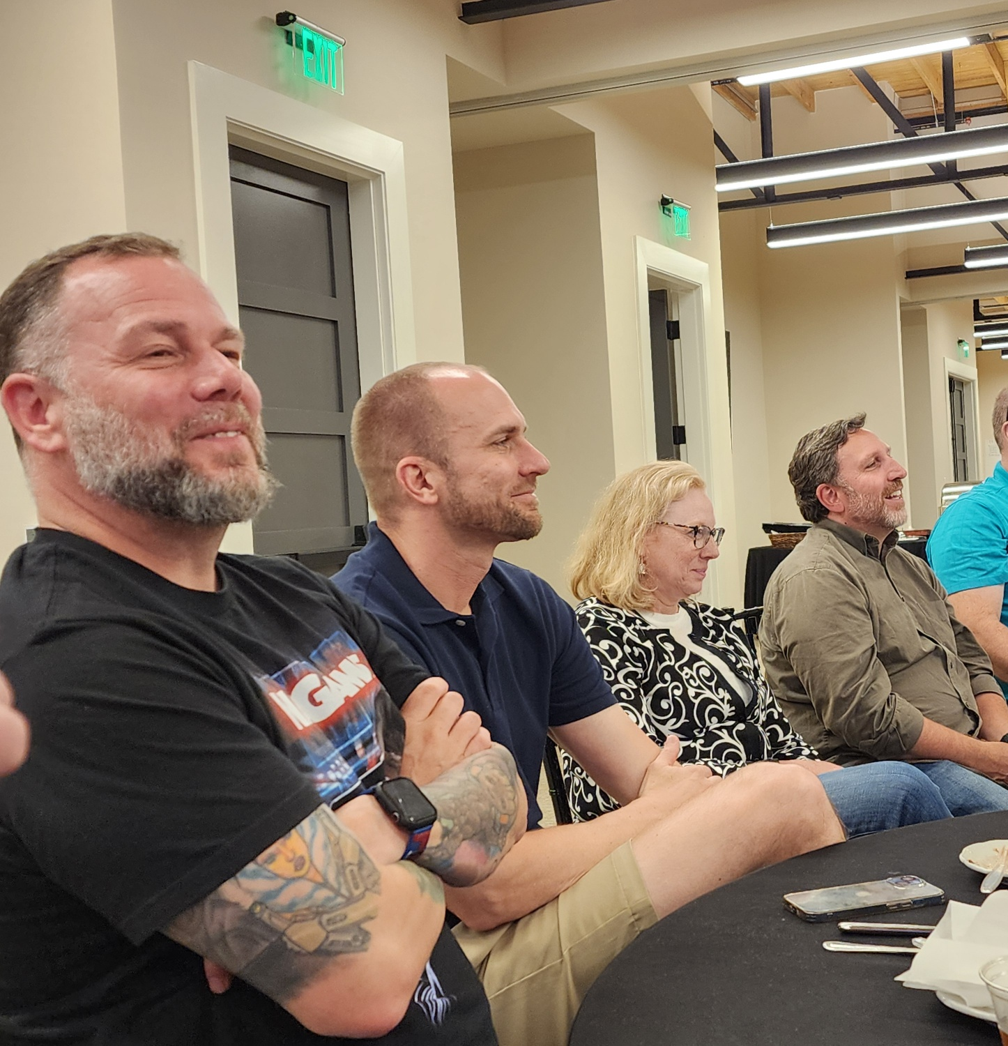
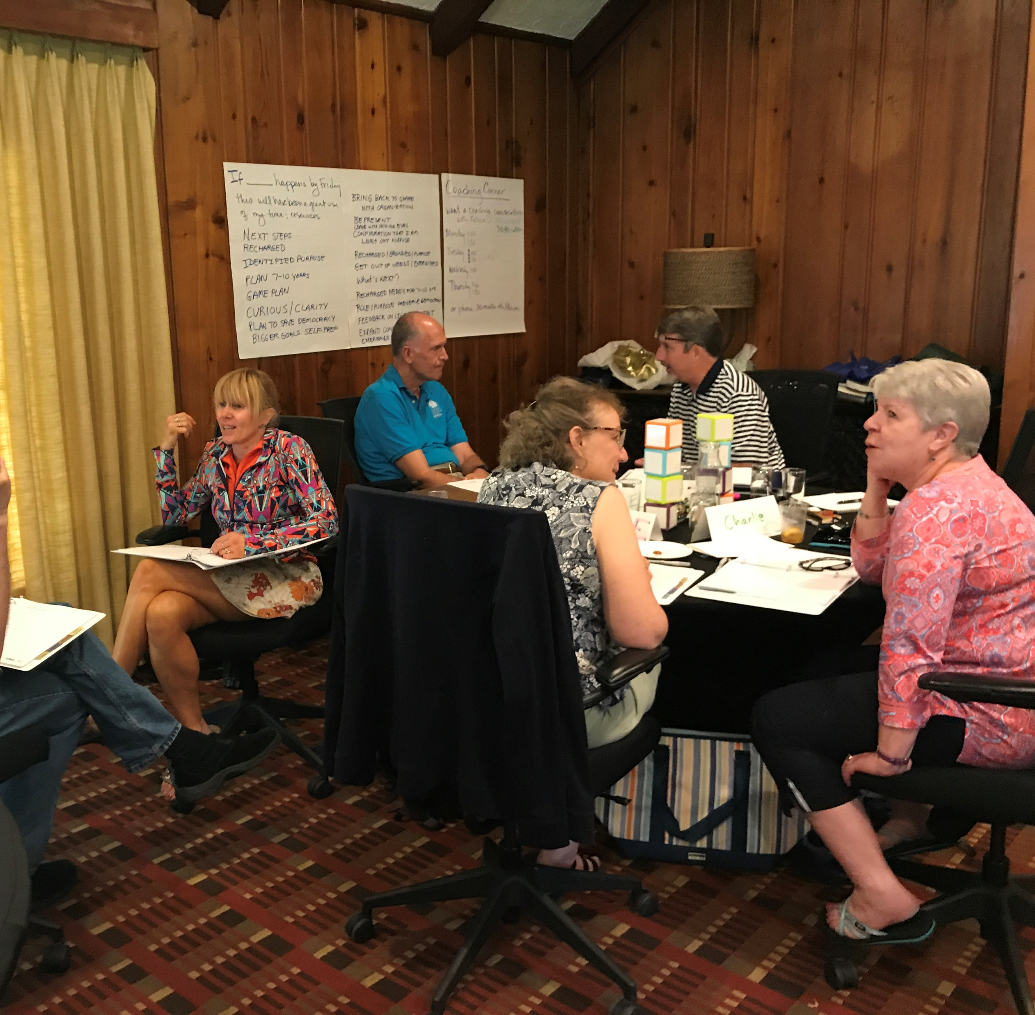

Slide 7
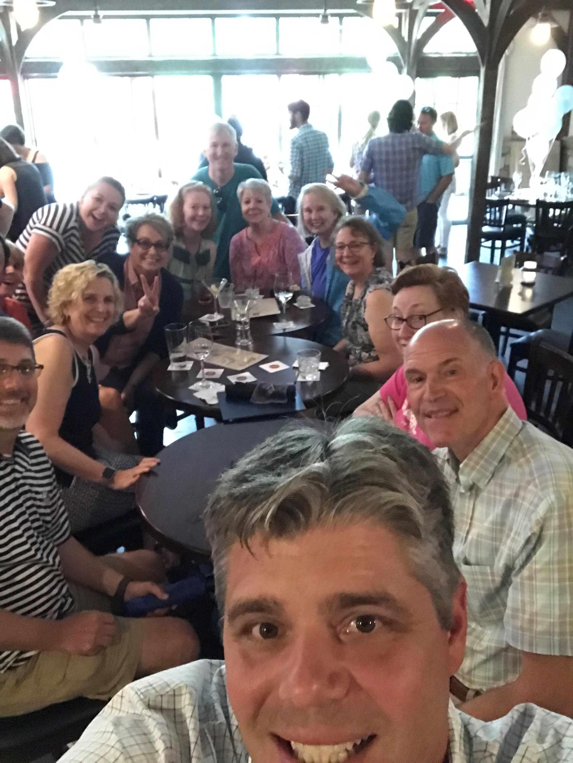
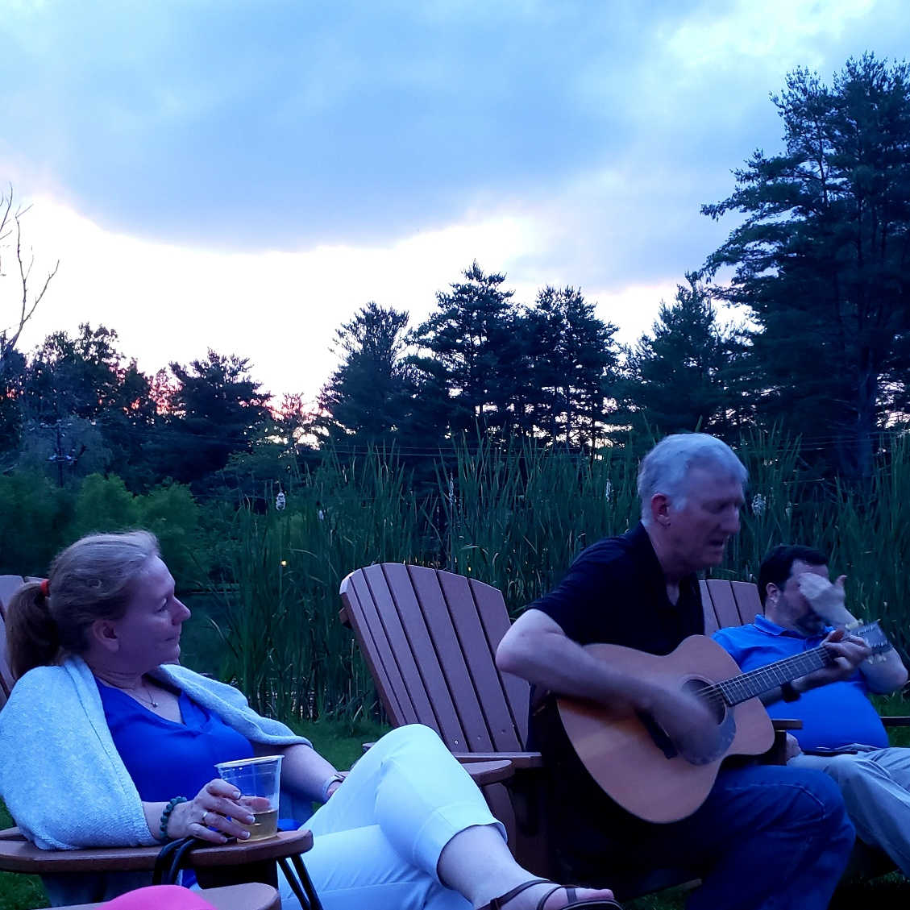
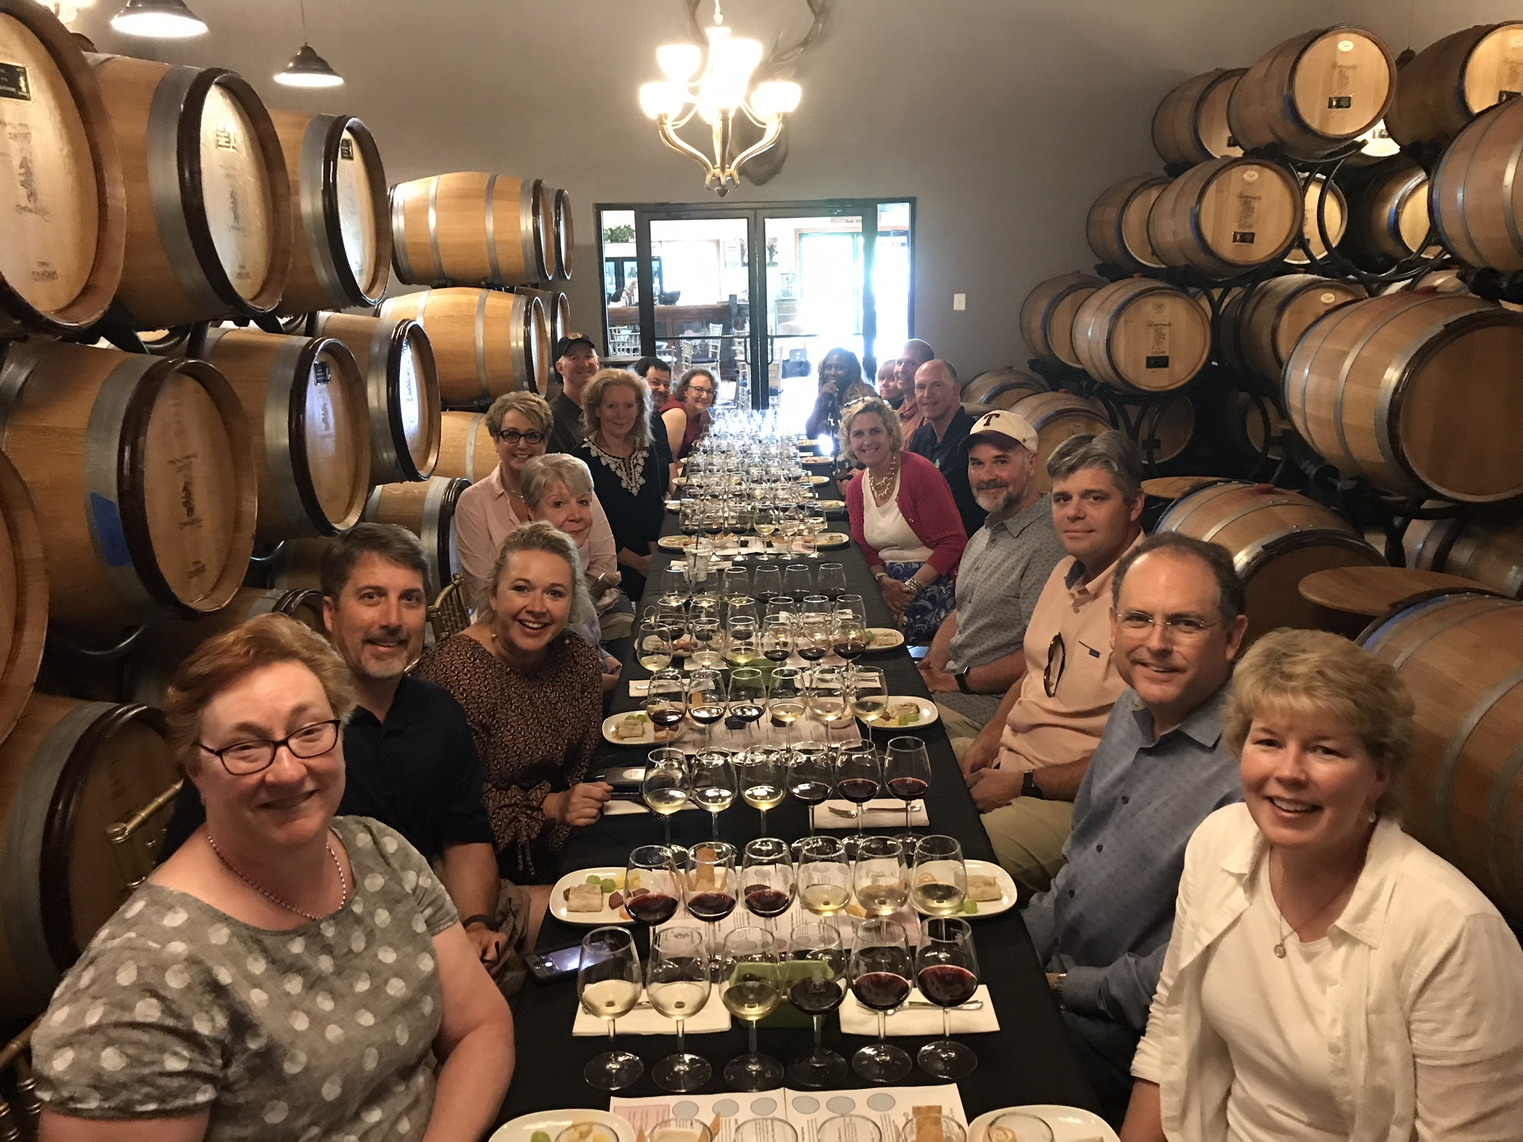

Slide 8
Jan. 1, 2025
Applications Accepted thru January 1, 2025
Dec. 6 2024
Participants are selected and confirmed
Early Jan. 2025
Pre-session Zoom Meeting for Participants
Late Jan. 2025
Pre-session Work is sent to Participants
Feb. 2025
Pre-session Participant Zoom session
Mar.30 – Apr. 4 2025
Program happens
What’s Next…..

Slide 9
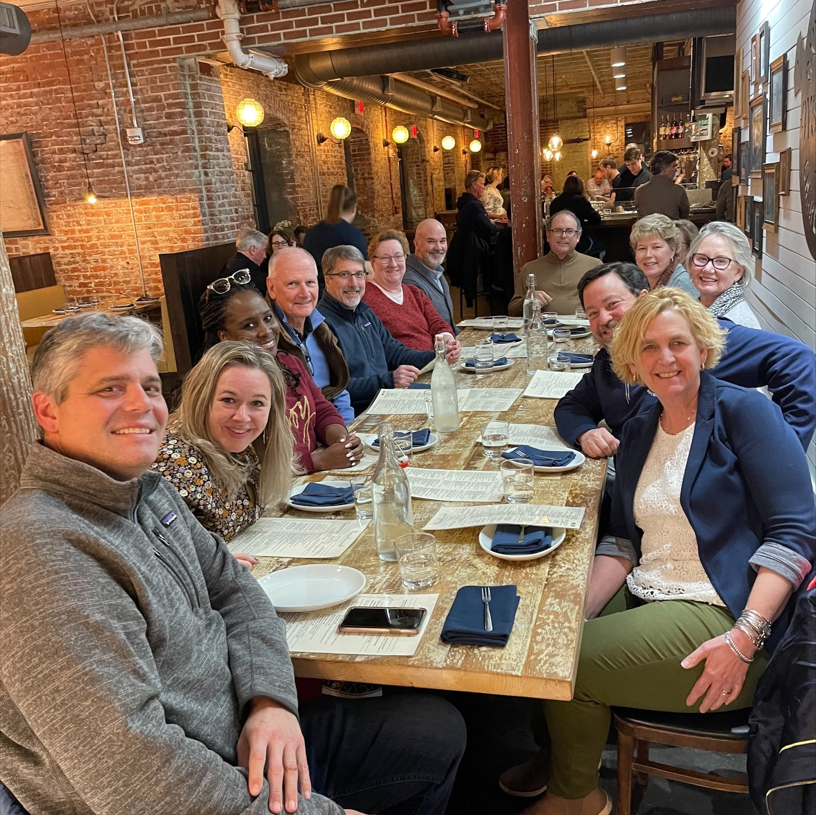
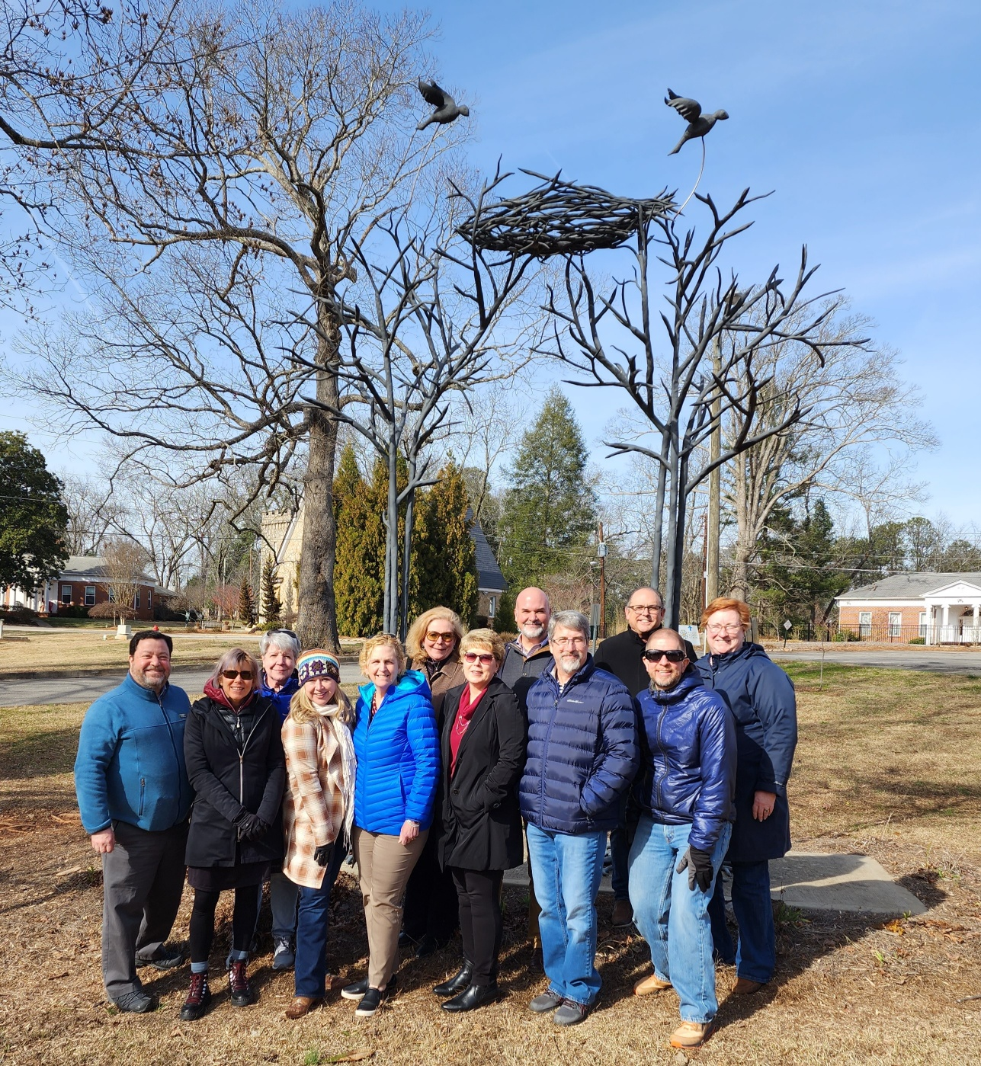
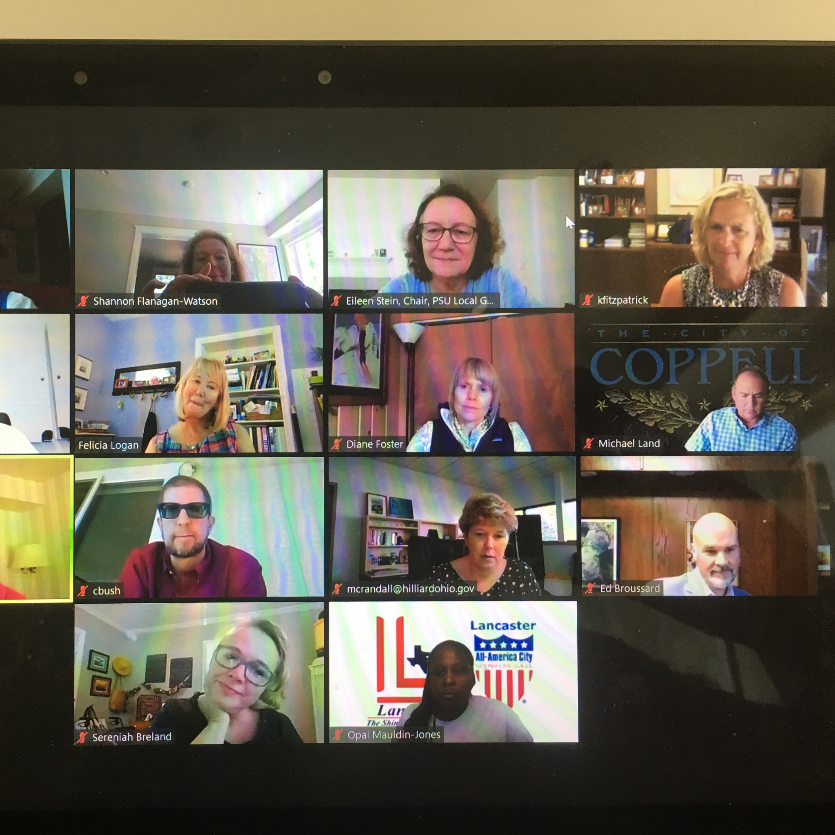

Slide 10
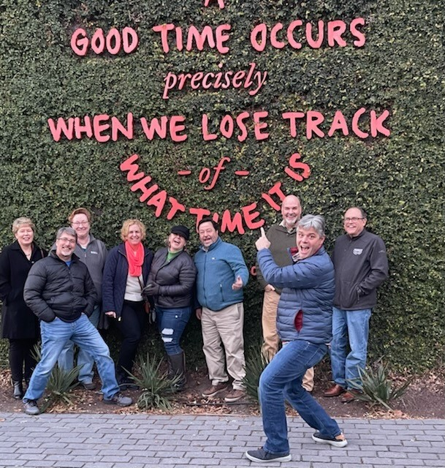
For Application and More Information:
Contact Peggy Merriss at merrissp@outlook.com or
Heather Zeidler at zeidlerhm@cofc.edu.
Use this link for direct access to the application: Athenian 25 Application

